Slide 1

Adders
CSE 131Digital Logic Design
Dr. Gamal Fahmy
Combinational Logic Design
© Gamal Fahmy

Slide 2
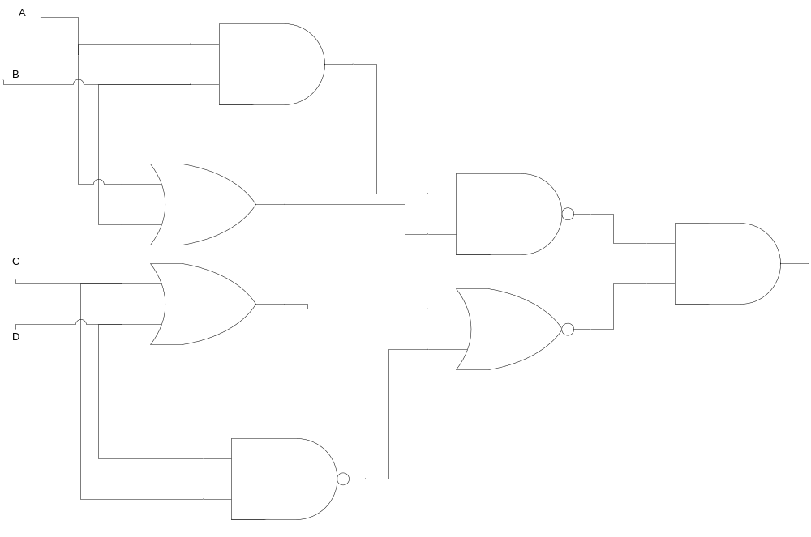
Combinational logic
© Gamal Fahmy

Slide 3
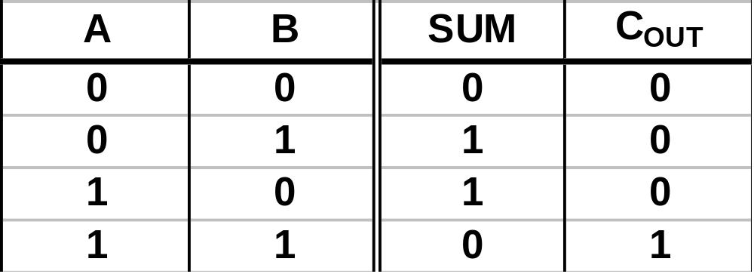
Adders
Assume we wish to add two 1 bit binary numbers and get a 2-bit result.
  A,B = 1-Bit Operands
  Result = C_{OUT}, Sum
B
B
B
B
B
B
B
B
B
B
B
B
B
B
B
B
B =>Binary Number
Think of these as logical variables rather than numerical variables and build a half-adder.
© Gamal Fahmy

Slide 4
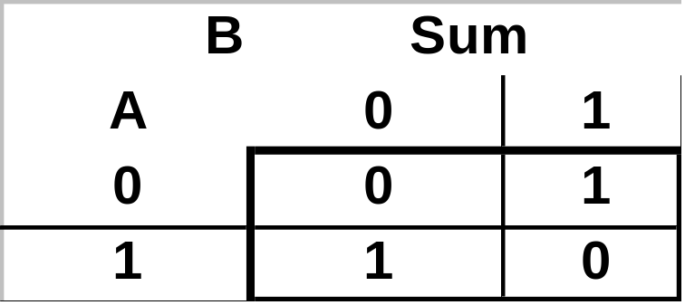
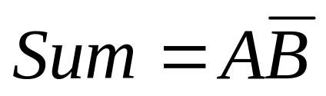
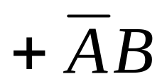

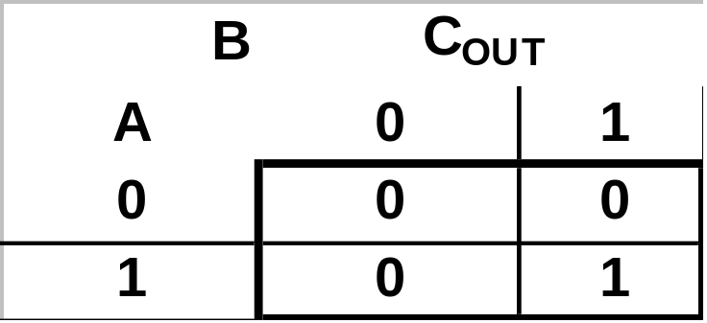

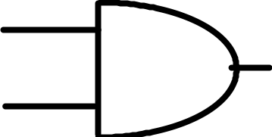

Adders
A
B
© Gamal Fahmy

Slide 5
Adders
Defn: Propagation Delay - The time between applying a input signal and getting a change of state at the output.
Defn: Gate Delay - Propagation delay for one gate.
Combinational Circuit Propagation Delay is usually measured in units of Gate Delays.
© Gamal Fahmy

Slide 6
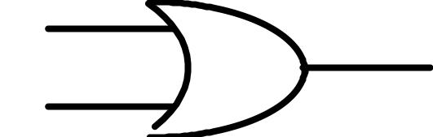

Adders
A
What is the propagation delay from each input to each output for our circuit?
B
Recall the XOR is built as:
A
B
From A/B to SUM
3 Gate Delays
From A/B to COUT
1 Gate Delay
© Gamal Fahmy

Slide 7
Adders
Considering our circuit as a “module” we can build more complex circuits from these modules.
Create a module by “putting circuit in a box.”
A
B
A B
H.A.
C_{OUT}
This is called a half adder because it cannot handle a carry-in from a less significant stage.
SUM
© Gamal Fahmy

Slide 8
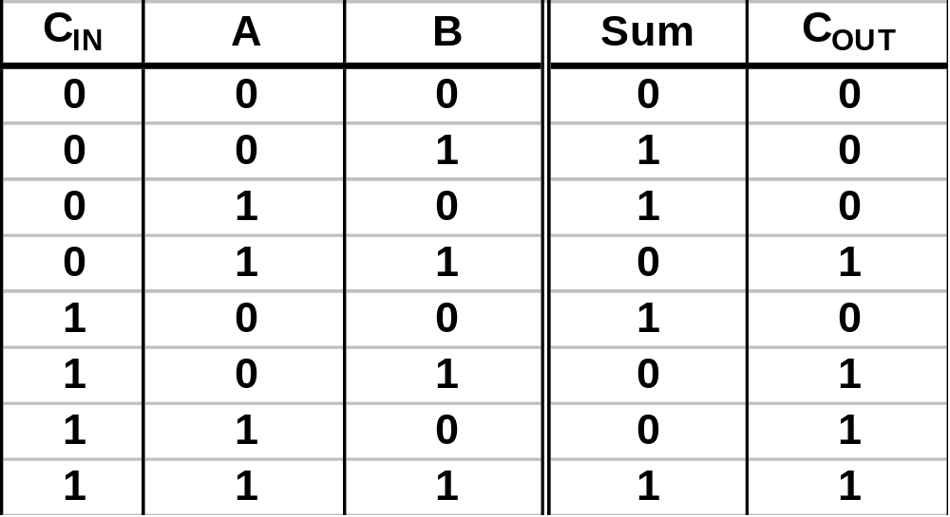
Adders
Lets Build A Full Adder
  A,B=1-Bit Addends
  C_{IN}=Carry-In from less significant stage
  SUM, C_{OUT} have the same definitions
B
B
B
B
B
B
B
B
B
B
B
B
B
B
B
B
B
B
B
B
B
B
B
B
B
B
B
B
B
B
B
B
B
B
B
B
B
B
B
B
© Gamal Fahmy

Slide 9
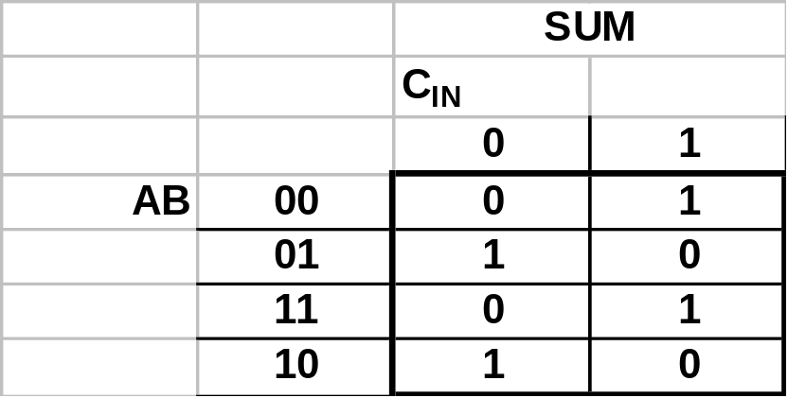
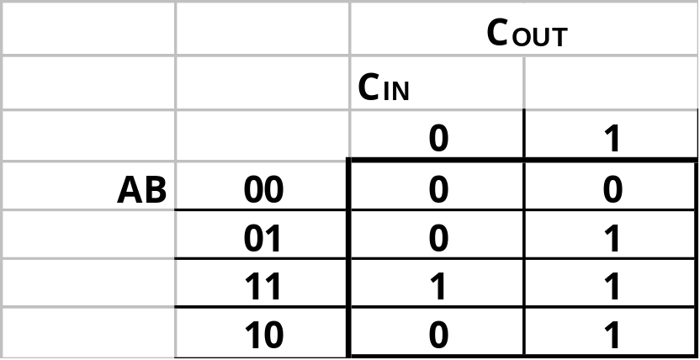


Adders
SUM is 1 when input combination has an odd number of 1’s.
© Gamal Fahmy

Slide 10




Adders
A
B
From A/B to SUM
6 Gate Delays
C_{IN}
From C_{IN} to SUM
3 Gate Delays
From A/B/C_{IN} to COUT
2 Gate Delay
© Gamal Fahmy

Slide 11
Adders
Put this circuit in a box.
A
B
C_{IN}
A B
F.A.
C_{OUT}
C_{IN}
SUM
This circuit is called a full adder.
© Gamal Fahmy

Slide 12
Adders
A/B to SUM
6 Gate Delays
C_{IN} to SUM
3 Gate Delays
A/B/C_{IN} to COUT
2 Gate Delays
C₂
C₁
C₀
A₃ A₂ A₁ A₀
+ B₃ B₂ B₁ B₀
C_{OUT} S₃ S₂ S₁ S₀
Four Bit Parallel Adder.
  We wish to add:
A₃
B₃
A₂
B₂
A₁
B₁
A₀
B₀
A B
A B
A B
A B
F.A.
C₂
F.A.
C₁
F.A.
C₀
F.A.
C_{IN}=0?
C_{OUT}
C_{IN}
C_{OUT}
C_{IN}
C_{OUT}
C_{IN}
C_{OUT}
C_{IN}
SUM
SUM
SUM
SUM
C_{OUT}
S₃
S₂
S₁
S₀
What is the addition time?(Assume A,B,C_{IN} become valid simultaneously.)
© Gamal Fahmy

Slide 13
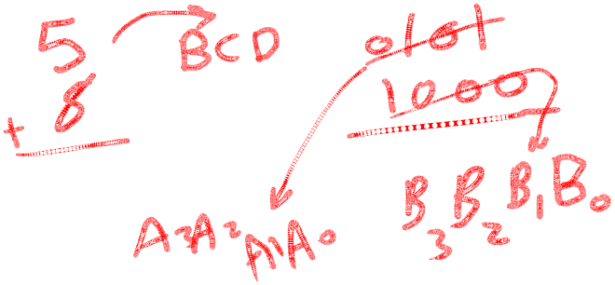
Adders
Four Bit Parallel Adder.
A₃
B₃
A₂
B₂
A₁
B₁
A₀
B₀
A B
A B
A B
A B
F.A.
F.A.
F.A.
F.A.
C_{IN}=0?
C_{OUT}
C_{IN}
C_{OUT}
C_{IN}
C_{OUT}
C_{IN}
C_{OUT}
C_{IN}
SUM
SUM
SUM
SUM
C_{OUT}
S₃
S₂
S₁
S₀
A₃A₂A₁A₀
B₃B₂B₁B₀
C_{OUT}
CIN
4-Bit Binary Adder
© Gamal Fahmy
S₃ S₂ S₁ S₀

Slide 14
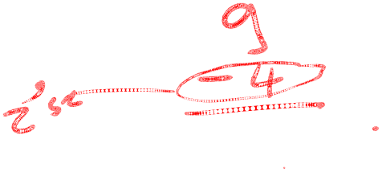
Adders
Let’s build a 2’s Complement Adder/Subtracter that detects overflows.
Under what conditions do we detect an overflow?
© Gamal Fahmy

Slide 15
Adders
Four-Bit 2’s Complement Adder with OF detect.
A₃
B₃
A₂
B₂
A₁
B₁
A₀
B₀
A B
A B
A B
A B
F.A.
F.A.
F.A.
F.A.
C_{IN}=0?
C_{OUT}
C_{IN}
C_{OUT}
C_{IN}
C_{OUT}
C_{IN}
C_{OUT}
C_{IN}
SUM
SUM
SUM
SUM
Cout
S₃
S₂
S₁
S₀
© Gamal Fahmy

Slide 16

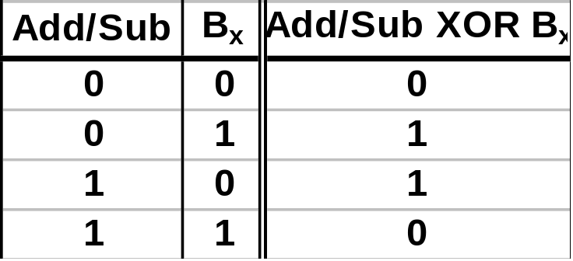
Adders
Four bit 2’s Complement adder/subtracter with OF detect.
Used in Neg/Not
Circuit in
Sim. Lab 3.
B₃ B₂ B₁ B₀
Add/Subtract
=0
=1
A₃A₂A₁A₀
C_{OUT}
4-Bit Binary Adder w/
Overflow Detect
C_{IN}
.
S₃ S₂ S₁ S₀
© Gamal Fahmy

Slide 17
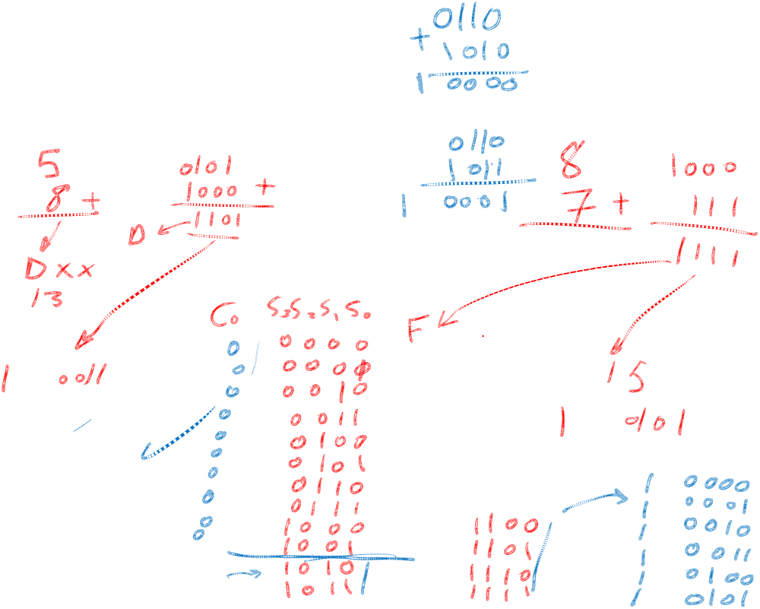

© Gamal Fahmy

Slide 18
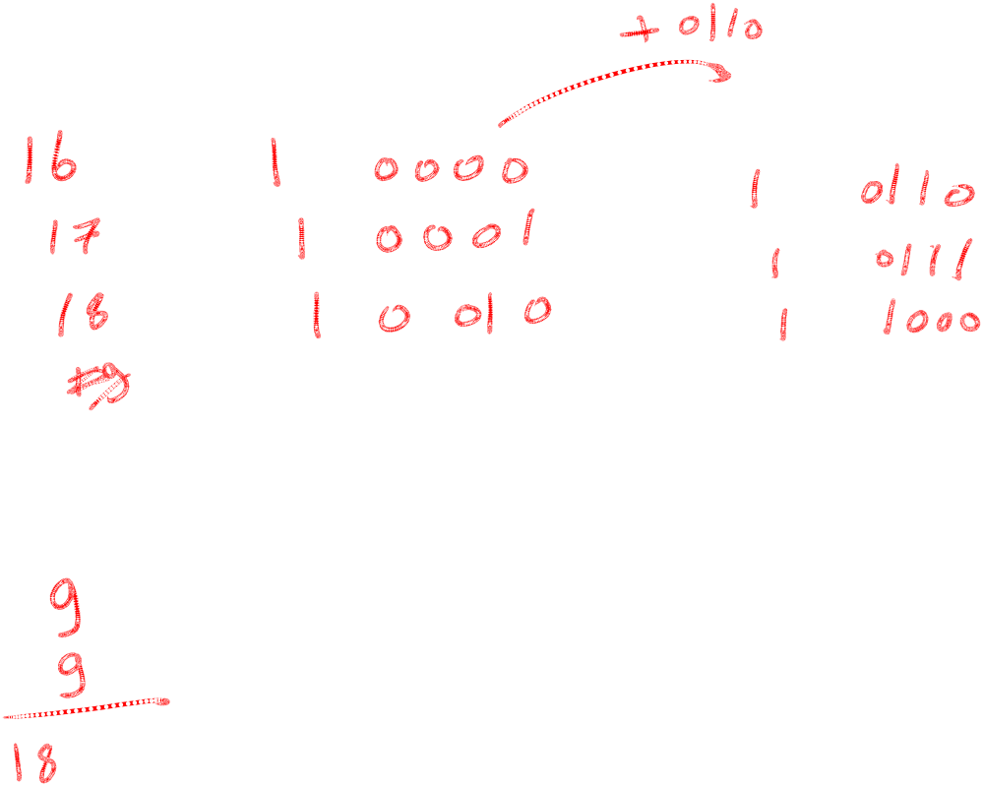
© Gamal Fahmy

Slide 19

Decimal Adder
K
4-bit binary adder
Z8 Z4 Z2 Z1
0
C=K+ Z8 Z4+Z8 Z2
4-bit binary adder
© Gamal Fahmy

Slide 20
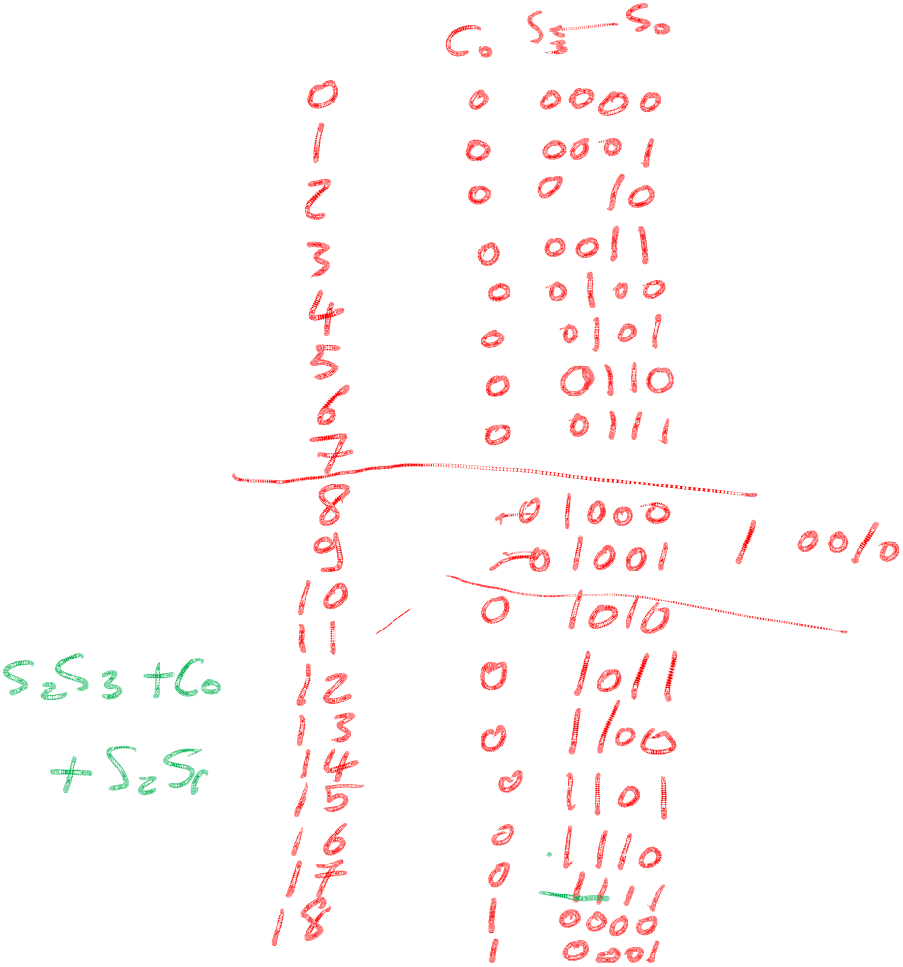
Adders
Homework
Do Homework 6
Check Logic works
© Gamal Fahmy

